Slide 1
INFOB240 – Initiation à l’autoapprentissage par les MOOC Bioinformatics Algorithms
Professors: Prof. Jean-Marie Jacquet – Prof. Laurent Schumacher
Student : Christian Nazili W.

Slide 2
Contents
Overview
Part I : Introduction
Part II : Algorithm and concepts
Part III : The problem

Slide 3

Overview (1-2)
This document presents one of two algorithms that we have been asked to submit for this subject.
Bioinformatics I - Finding Hidden Messages in DNA
Bioinformatics II - Algorithms for DNA Sequencing
Bioinformatics III - Comparing Genes, Proteins, and Genomes
Note: The programming language used is Python 2.7.13.

Slide 4
Overview (2-2)
One algorithm is in the second part and other in the last part of Bioinformatics (i.e. : Bioinformatics II - Algorithms for DNA Sequencing and Bioinformatics III - Algorithms for DNA Sequencing and Comparing Genes, Proteins, and Genomes) :
From Euler's Theorem to an Algorithm for Finding Eulerian Cycles
The Changing Faces of Sequence Alignment
I chose to do “From Euler's Theorem to an Algorithm for Finding Eulerian Cycles”

Slide 5
Part I: Introduction
Notes:
Skip

Slide 6
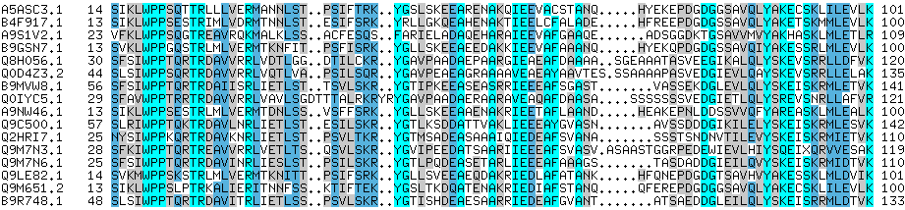
Bioinformatics – what is it?
Bioinformatics is a multidisciplinary research field where biologists, physicians, computer scientists, mathematicians, physicists and bioinformaticians work together in a scientific problem posed by biology.
Notes:
Skip

Slide 7
How is computer science involved?
The primary goal of bioinformatics is to increase the understanding of biological processes.
What sets bioinformatics apart from other approaches is its focus on developing and applying computationally intensive techniques to achieve the goal.
Computer scientist helps other disciplines
Notes:
Skip

Slide 8
Part II: Algorithm and concepts
“From Euler's Theorem to an Algorithm for Finding Eulerian Cycles”
…

Slide 9
Prerequisites (1-2)
From Euler's Theorem to an Algorithm for Finding Eulerian Cycles is found in the bioinformatics II (Algorithms for DNA Sequencing and Comparing Genes).
Euler’s Theorem to an Algorithm for finding Eurelian Cycles was taught by Ben Langmead, Assistant Professor of Computer Science and Jacob Pritt at Johns Hopkins University.

Slide 10
Prerequisites (2-2)
The Changing Faces of Sequence Alignment is found in the bioinformatics III (Algorithms for DNA Sequencing and Comparing Genes, Proteins, and Genomes).
The changing Faces of Sequence Alignement was taught by :
Pavel Pevzner, Professor, University of California, San Diego
Phillip E. C. Compeau, Assit Teaching Professor (Carnegie Mellon University)
Nikolay Vyahhi, Visiting Scholar

Slide 11
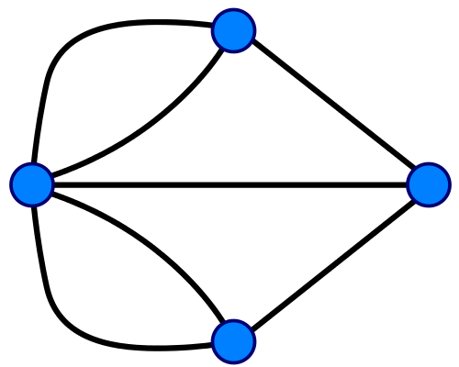
Some definitions
A graph is a triple (V, E, ψ) :
V is a set whose elements are called nodes
E is a set whose elements are called edges
B
1
3
2
C
A
6
5
7
D

Slide 12
Eulerian Path
In graph theory, Eulerian path is the path in a graph that traverses each node exactly once.
The Eulerian circuit is a path which forms a loop, that is to say the beginning and the end on the same node.
An Euler path starts and ends at different node.
An Euler circuit starts and ends at the same node.

Slide 13
Euler Paths and Euler Circuits
B
A
C
E
D
An Euler circuit : BBADCDEB
An Euler path : CDCBBADE

Slide 14
Euler’s Theorem
A connected graph is Eulerian if and only if all its nodes are of even degree
If a graph G has an Euler path, then it must have exactly two odd vertices

Slide 15
In Bioinformatics
Adenine, Cytosine, Guanine, or Thymine, which are abbreviated to A, C, G, and T.
Their famous form, the double helix, is composed of two long chains (or strands) twinned and complementary: each A faces a C, each G a T.
The method known as shotgun sequencing consists in performing a myriad of readings on segments (called inserts) taken at random in the genome
Notes:
Le génome d'une espèce est, rappelons-le, composé d'un ensemble de molécules d'ADN, réparties en chromosomes (voire en plasmides pour certaines bactéries). Ces molécules sont des polymères formés à partir de seulement quatre molécules élémentaires, qui ne diffèrent que par la base aminée qu'elles portent --- Adényne, Cytosine, Guanine, ou Thymine, que l'on abbrège en A, C,G, T. Leur célèbre forme, la double hélice, est composée de deux longues chaînes (ou brins) jumelées et complémentaires: chaque A fait face à un C, chaque G à un T. c'est le code génétique de l'espèce. Ici nous allons détermination de ce code; mais l'interprétation du code est aussi un défi majeur pour la bio-informatique.
la méthode consiste à créer par polymérisation des copies des préfixes du codes, colorés (littéralement!) en fonction de leur dernière lettre. On trie alors ces préfixes par poids moléculaire (par électrophorèse) pour lire le code. Malheureusement, la précision du tri et le rendement de la polymérisation diminuent avec la longueur des préfixes. La méthode de séquençage aléatoire consiste à effectuer une myriade de lectures sur des segments (appelés inserts) pris au hasard dans le génome. L'ensemble des fragments lus, mis bout à bout, couvriraient environ 10 fois la longueur du génome. On tente ensuite d'obtenir algorithmiquement un assemblage de ces fragments en utilisant leurs chevauchements

Slide 16
In Bioinformatics
Construct a graph
A vertex for each (l− 1)-mer
An edge between two vertices corresponds to an l-mer from S
Find a path that visits each edge once.
s = TATGGTGC, Spectrum(s, 3):
S = {ATG, TGG, TGC, GTG, GGC, GCA, GCG, CGT}
V = {AT, TG, GG, GC, GT, CA, CG}

Slide 17
In Bioinformatics
S = {ATG, TGC, GTG, TGG, GGC, GCA, GCG, CGT}
GT
CG
AT
TG
GC
CA
GG
GT
CG
GT
CG
AT
TG
GC
CA
AT
TG
GC
CA
GG
GG

Slide 18
Part III: The problem

Slide 19
The Eulerian Cycle Problem
CODE CHALLENGE: Solve the Eulerian Cycle Problem.
Input: The adjacency list of an Eulerian directed graph.
Output: An Eulerian cycle in this graph.
Sample input | Sample output
0 -> 3 1 -> 0 2 -> 1,6 3 -> 2 4 -> 2 5 -> 4 6 -> 5,8 7 -> 9 8 -> 7 9-> 6 | 0->3->2->6->8->7->9->6->5->4->2->1->0

Slide 20
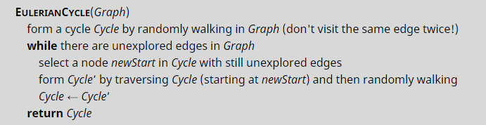
Implementing Eulerian Cycle (1-2)
To solve this problem, we use a pseudocode accessible to the public on the Coursera / Stepic platform.
The movements are followed until an Eulerian cycle is produced in the graphe.
As summarizes the pseudocode below

Slide 21
Implementing Eulerian Cycle (2-2)
To solve this problem in Python, we need the following variables and data :
edges = dictionary (each key is separated from it’s value by a colon (:), the items are separated by commas and the whole thing is enclosed in curly braces. Empty dictionary: {}). (e.g. dict = {‘Name’: ‘Zara’, ‘Age’: 7, ‘Class’: ‘First’}; - where keys are: Name, Age, Class; and values are: Zara, 7, First).
edge = list (versatile datatype; written as a list of comma-separated values (items) between square brackets). (e.g. list1 = [‘physics’, ‘chemistry’, 1997];).
path = list;

Slide 22
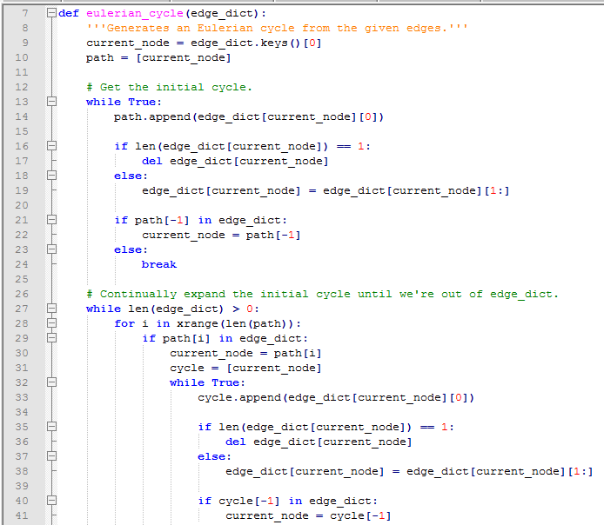
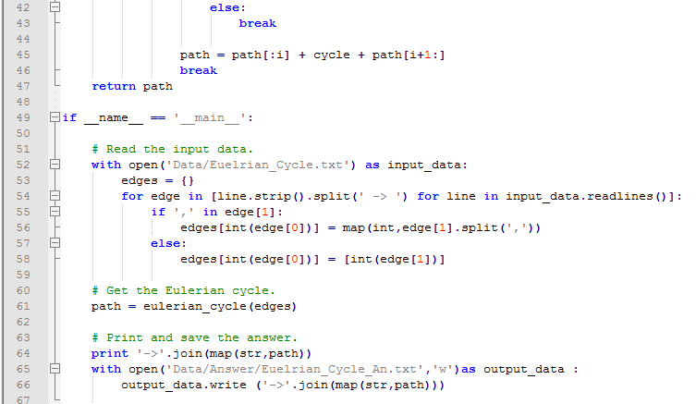
The code:

Slide 23
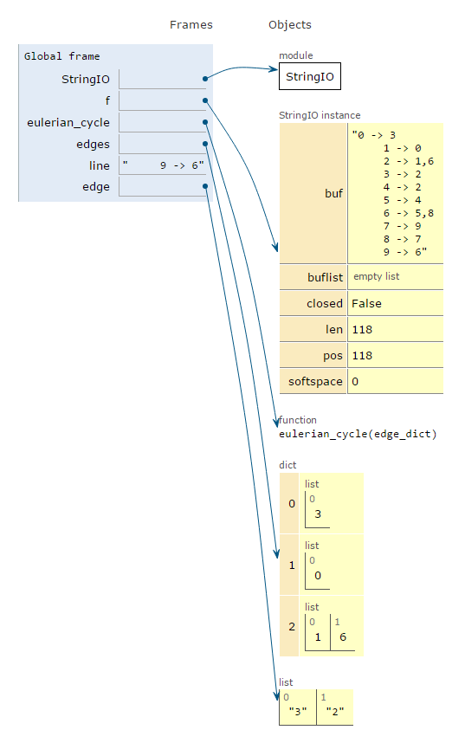

Code visualization (1-7)
Let's look at how data interpretation works in the algorithm.
The edges dictionary contains the lines already read, with starting edge as a key and destination edge (s) as a list. The current condition is that it will be tested under the condition.

Slide 24
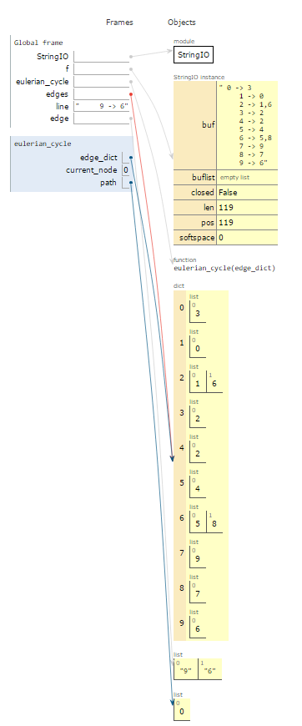
Code visualization (2-7)
After completing the data interpretation, a call is made to the eulerian_cycle function. The list Path is generated and will contain eulerian_cycle(edges) after the function execution. First we go through the dictionary to get the initial cycle.
To start, we set current_node to the first key in the edge_dict dictionary. (which is essentially the same as edges). It is to be noted that the list at this point contains only the first key, 0.

Slide 25
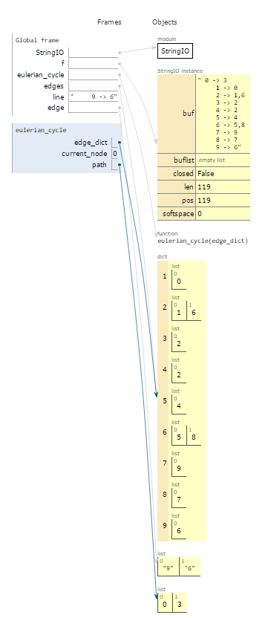

Code visualization (3-7)
The first instruction in the while loop appends the first value for which the key is the current_node to the path list.
The first if condition in the loop deletes the key (key = current_node) and the value from the edge_dict dictionary if there is only one value, or it replaces the first value of this key with the next value.

Slide 26
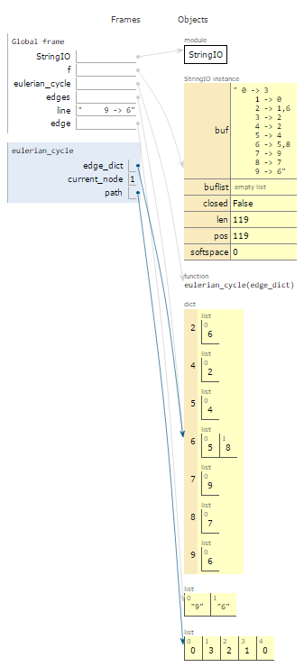

Code visualization (4-7)
The code:
updates current_node with the most recent appended value in path if this value exists as a key in edge_dict, or else it breaks the loop. If the update is successful, it means that an initial but yet incomplete cycle is found and it is assumed to be the case.

Slide 27
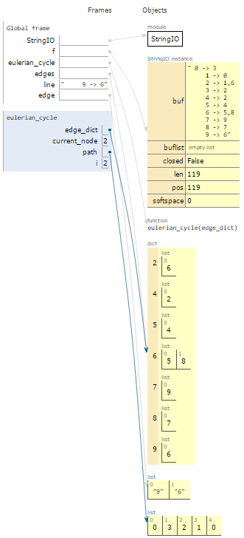
Code visualization (5-7)
For the second part of the function, we set the following condition: while the length of the edge_dict dictionary is greater than 0, we continually expand the initial cycle until we are out of edge_dict.
We consider i as a counter, starts from zero and increments by 1 to length(path).
When there is a value i for which a key corresponds in edge_dict, we set current_node to path[i].

Slide 28
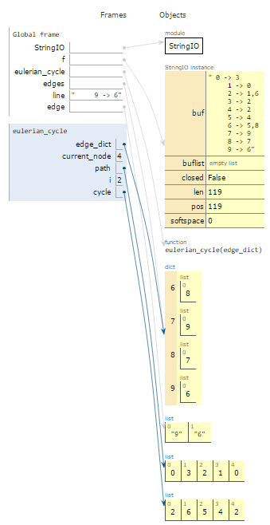
Code visualization (6-7)
Next, we create the list called cycle.
Using the same principles as in the first part of the function, we set the first value of this list to the value path[i].
Next, we use a slightly modified version of the While True: loop as in the first part of the function, designed to work with cycle instead of path, both being lists.
The cycle list is then attached to path, using the instruction below:

Slide 29
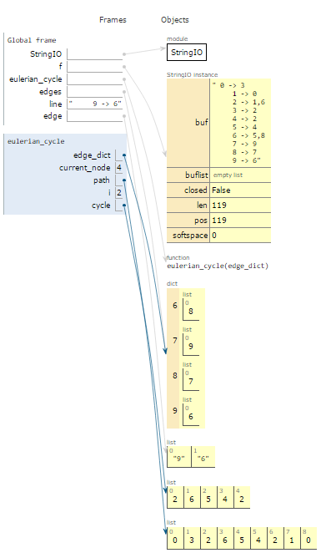
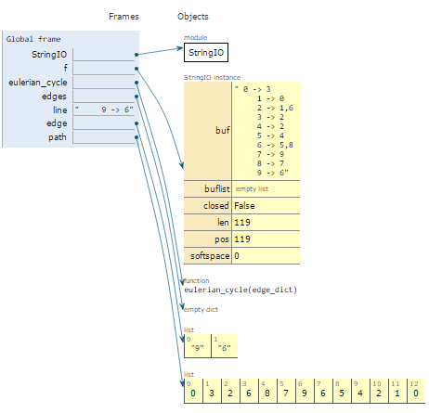
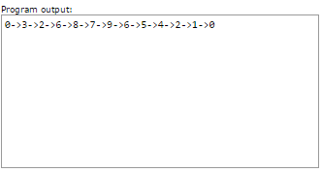
Code visualization (7-7)
When and if we reach another “dead end”, the algorithm is run again. When edge_dict is empty, path will contain the cycle we are looking for.

Slide 30
Data: in/out
0 -> 1516,3,4,9
1 -> 2,23
10 -> 109,11
100 -> 13,199
1000 -> 1002
1001 -> 810
1002 -> 1001
1003 -> 49
1004 -> 1005
1005 -> 1003
1006 -> 1007
1007 -> 1008,1266
1008 -> 1793,703
1009 -> 1010,1275
101 -> 100,1610
1010 -> 1011,2658
1011 -> 1206,947
1012 -> 1013,1496
1013 -> 1014,1347
1014 -> 833
1015 -> 1016
1016 -> 935
1017 -> 1015
1018 -> 1020
1019 -> 2559,611
102 -> 101,927
0->1516->1518->1517->1700->1701->2127->2288->2287->2289->2127->2125->2985->2983->2984->2125->2126->1701->1699->1517->0->3->68->69->67->613->1431->1430->1429->613->614->615->2890->2891->2892->615->67->78->1410->2050->2051->2370->2368->2369->2051->2052->1410->1408->1409->78->335->1555->1557->1556->335->334->1227->1226->1225->334->336->2595->2880->2879->2878->2595->2594->2593->336->78->77->218->219->337->338->575->2271->2270->2269->575->576->723->800->799->801->1034->1035->1033->2967->2966->2965->1033->801->1530->1529->1528->801->2255->2254->2256->801->723->722->1319->1318->1320->722->721->741->739->740->721->576->1907->1906->1908->2161->2163->2162->1908->576->574->338->339->2364->2362->2363->339->2994->2993->2992->339->219->572->573->752->753->751->573->571->880->1702->1703->1704->880->881->882->571->1505->1504->1506->571->219->217->813->2224->2225->2226->813->812->1638->1637->1636->812->811->896->895->897->2404->2406->2405->897->811->1161->1160->1159->811->217->77->2531->2532->2530->77->76->250->825->823->824->250->1121->1120->1122->1392->1391->1390->1122->250->1712->1711->1713->2157->2155->2728->2730->2729->2155->2156->1713->250->251->482->483->988->1088->1145->1903->1904->1905->1145->1144->1146->1088->1087->1089->988->1484->1483->1485->988->989->990->483->481->251->252->76->67->3->1->23->26->1189->1190->1191->26->27->74->1486->1522->1523->1524->1486->1804->1805->1806->1486->1488->2635->2637->2636->1488->1487->74->73->75->545->2398->2400->2399->545->546->544->75->170->171->473->472->474->171->1598->1597->1599->171->169->1271->1272->1270->2436->2434->2435->1270->169->75->173->651->649->650->173->174->175->1415->1416->1414->175->176->816->814->815->1914->1913->1912->815->1915->2519->2518->2520->1915->1917->1967->1966->1968->1917-
…
Notes:
Imagine that you must that result, how long it can take

Slide 31
Bibliography
Resources used:
https://coursera.org/
http://bioinformaticsalgorithms.com/
https://www.python.org/doc/
http://www.pythontutor.com/
Bioinformatics Algorithms: An Active Learning Approach, 2nd Ed., Active Learning Publishers; 2nd edition (2015), ISBN-13: 978-0990374619
Python for Biologists: A complete programming course for beginners, CreateSpace Independent Publishing Platform; 1st edition (September 7, 2013), ISBN-13: 978-1492346135
Théorie des graphes, Université de Namur, Prof. Renaud Lambiotte, 2016-2017

Slide 32
Bibliography
3. Fleischmann RD, Adams MD, White O, Clayton RA, Kirkness EF, Kerlavage AR, et al. Whole-genome random sequencing and assembly of Haemophilus influenzae Rd. Science. 1995;269:496–512.
4. Fraser CM, Gocayne JD, White O, Adams MD, Clayton RA, Fleischmann RD, et al. The minimal gene complement of Mycoplasma genitalium. Science. 1995;270:397–403.
5. Cole ST, Brosch R, Parkhill J, Garnier T, Churcher C, Harris D, et al. Deciphering the biology of Mycobacterium tuberculosis from the complete genome sequence. Nature. 1998;393:537–544.

